Slide 1
Tikzify: AI-powered LaTeX Diagram Generator for Academic Research
IBM-EDUNET-AICTE PROJECT
Presented By: Shreya Patel
Student Name: Shreya Patel
College Name & Department: Sarvajanik College of Engineering and Technology, Surat, & Computer Engineering

Slide 2
OUTLINE
Problem Statement
Technology used
Wow factor
End users
Result
Conclusion
Git-hub Link
Future scope
IBM Certifications

Slide 3
Problem Statement
Researchers, students, and academic writers often struggle to create professional-quality LaTeX diagrams due to the complexity of TikZ syntax and the time-consuming nature of manual coding. This creates a barrier for non-experts and slows down the documentation process in academic and technical writing.
PROPOSED SOLUTION:
TikZify is an AI-powered assistant/agent that converts plain natural language descriptions into clean, publication-ready LaTeX diagrams using TikZ. It supports real-time feedback and refinement commands, allowing users to iteratively build diagrams without writing any code — significantly simplifying the diagram generation workflow for academic use.

Slide 4
Technology used
IBM Cloud Lite Services
Natural Language Processing (NLP)
Retrieval Augmented Generation (RAG)
IBM Granite Model
Prompt-based AI technology for conversational flows
ReAct Architecture
LangGraph

Slide 5
IBM cloud services used
IBM Cloud Watsonx AI Studio
IBM Cloud Watsonx AI Runtime
IBM Cloud Agent Lab
IBM Granite Foundation Model

Slide 6
Wow factors
Natural language to TikZ code generation Users describe diagrams in plain English, and TikZify generates valid LaTeX code
Interactive refinement with follow-up commands Allows users to modify diagrams in real-time without rewriting prompts
Produces publication-ready diagrams Outputs are clean, structured, and LaTeX-compatible for research papers and technical documents
Domain-restricted AI assistant Specifically focused on LaTeX diagram generation — avoids irrelevant responses
No manual coding needed Ideal for non-experts in TikZ or LaTeX, removing the barrier to entry
Modular and scalable design Architecture supports future extensions such as more diagram types or template styles
Demo-friendly and visually impactful Generates instant results suitable for live presentations and academic demos

Slide 7
End users
Researchers
Graduate and PhD Students
Professors and Academic Writers
Engineering and Computer Science Students
LaTeX Beginners
Technical Content Creators and Educators
Open-source Contributors and Documentarians

Slide 8
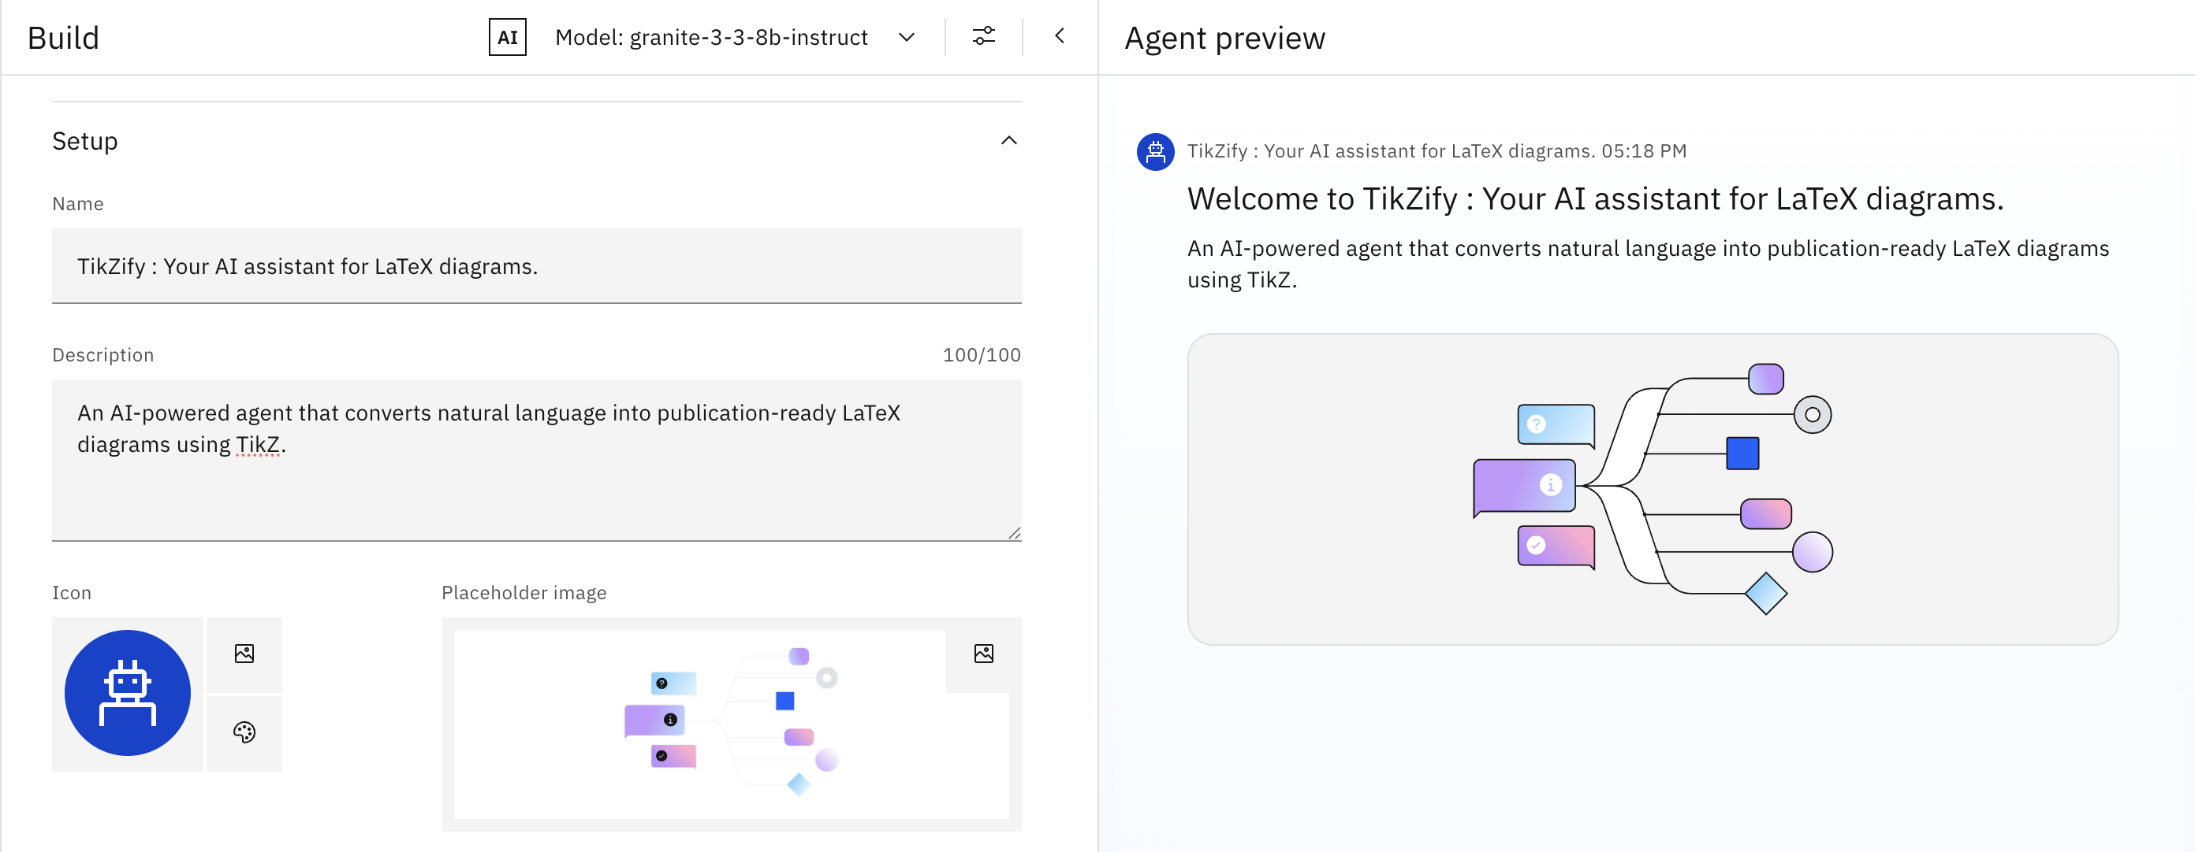
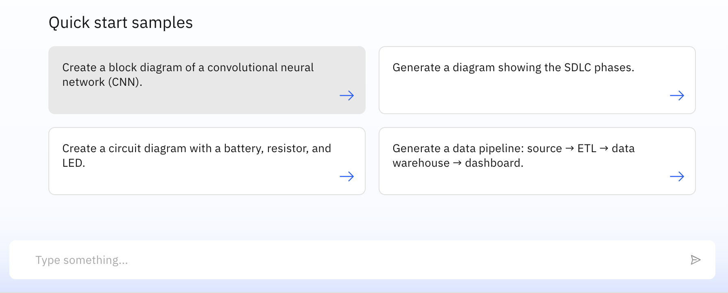
Results
AI Agent Preview

Slide 9
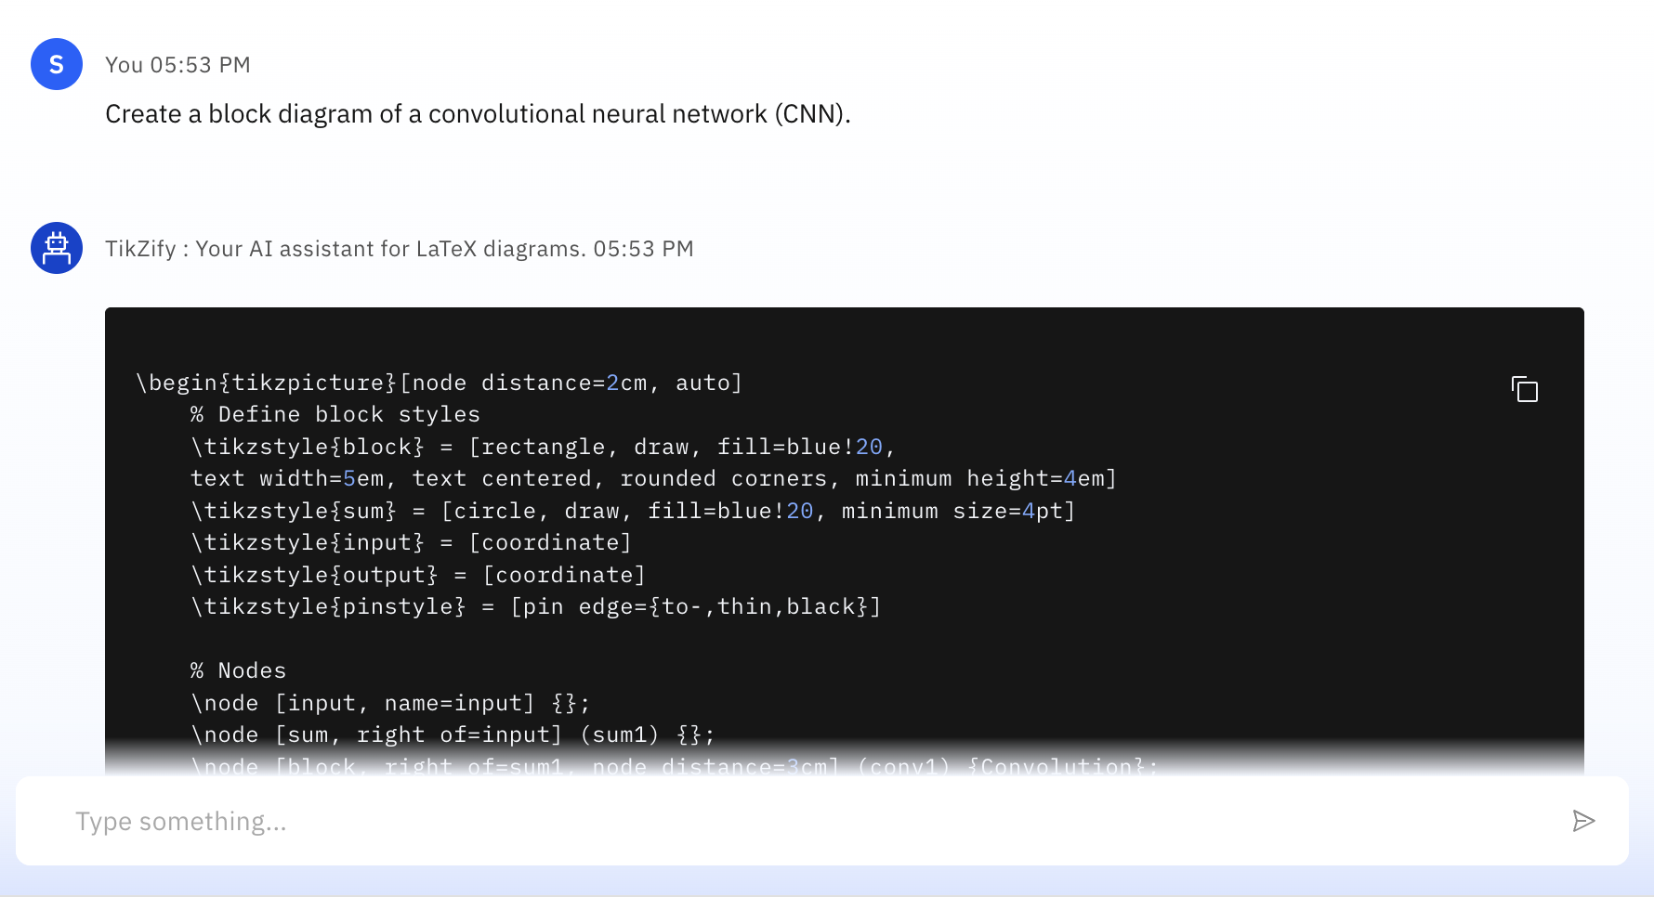
Results
Basic Generation Prompt

Slide 10
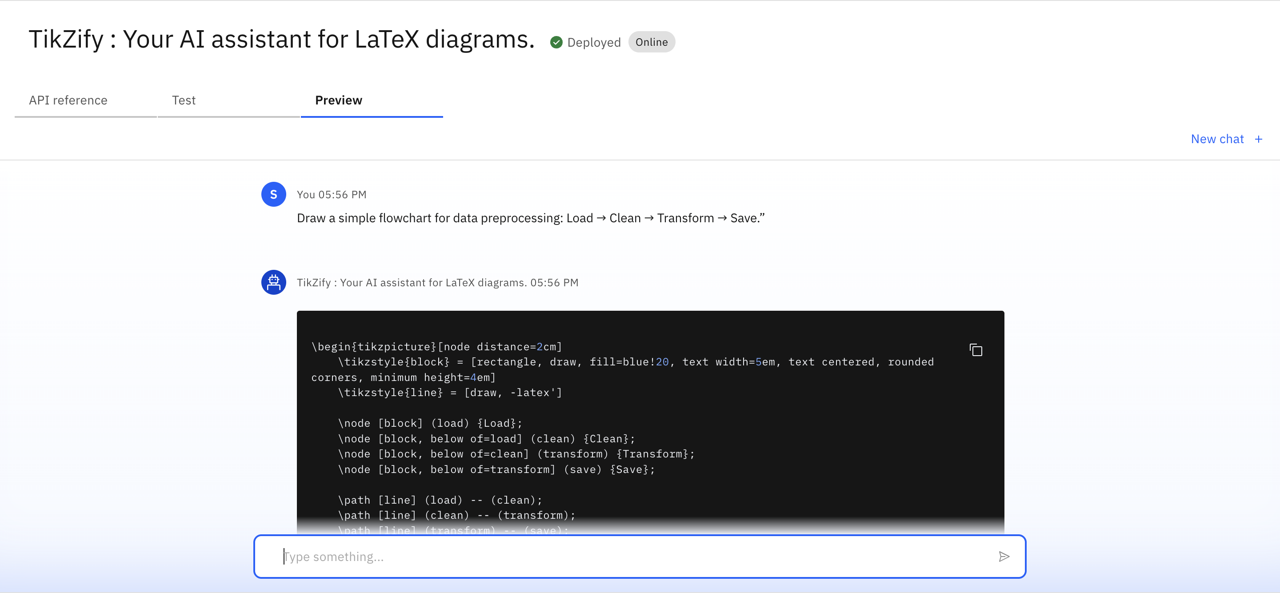
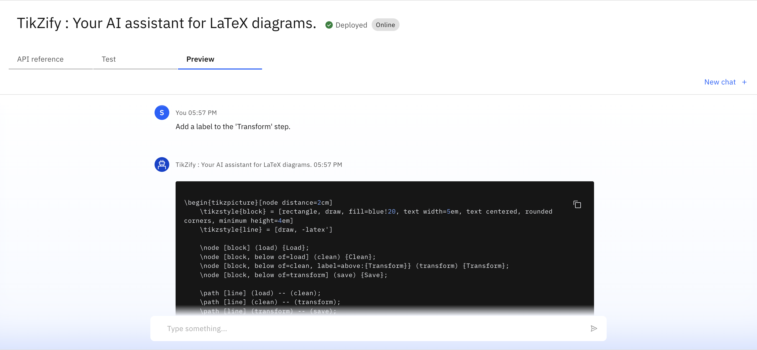
Results
Refinement via Follow-up:
Users can make changes to the diagram by giving simple follow-up instructions.

Slide 11
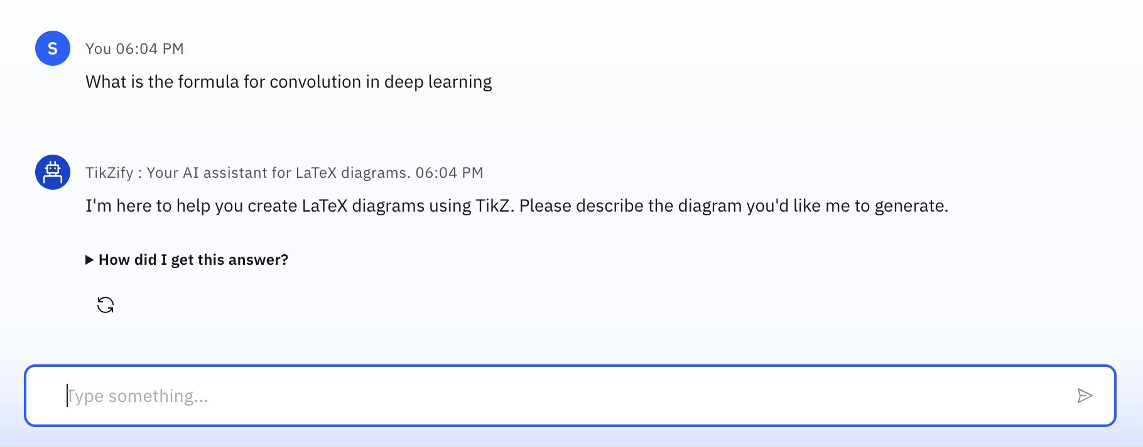
Results
Domain Restriction (Off-topic Question Handling):
It shows proper rejection of off-topic queries.

Slide 12
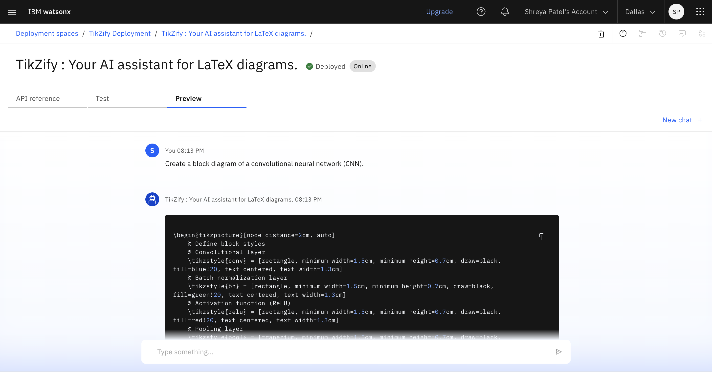
Results
Deployed AI Agent

Slide 13
Conclusion
TikZify demonstrates how AI can simplify the traditionally complex process of LaTeX diagram creation.
By allowing users to generate professional-quality TikZ diagrams from plain natural language, it eliminates the need for manual coding and lowers the barrier for researchers, students, and educators.
The system supports real-time refinement, producing clean, publication-ready outputs ideal for academic documents.
Built entirely using IBM Watsonx.ai and Granite foundation models on the IBM Cloud Lite platform, TikZify highlights the practical impact of domain-specific AI agents in enhancing productivity and accessibility in research workflows.

Slide 14
GitHub Link
Repository Link: https://github.com/shreya2034/TikZify-LaTeX-Diagram-Generator-Agent

Slide 15
Future scope
Add sketch-to-diagram support
Enable live TikZ preview
Support more LaTeX packages
Allow voice input for diagrams
Provide diagram template library with reusable structures
Incorporate document-aware refinement
Edit based on uploaded .tex files

Slide 16
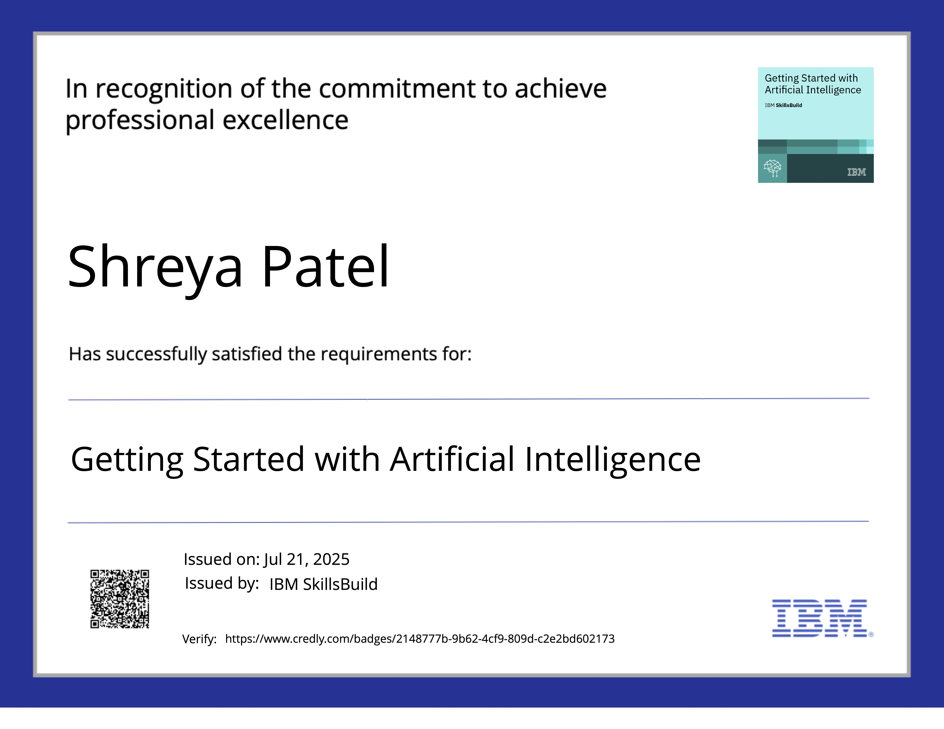
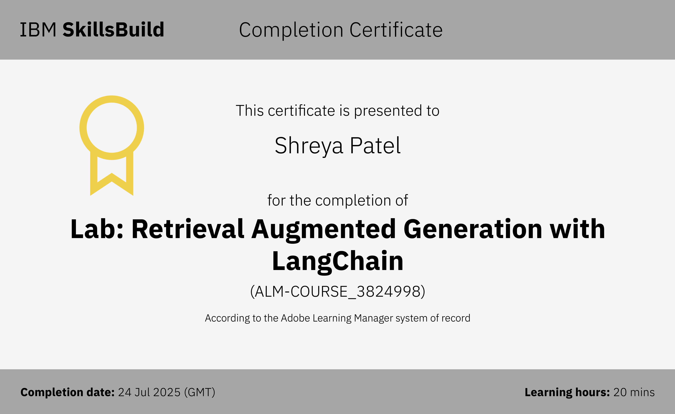

IBM Certifications

Slide 17
THANK YOU

